Slide 1
Database and Invoicing Application for Small Business
David K. Hwang
Kansas State University
CIS598 – Fall 2019

Slide 2
Overview
Project Goals
Requirements
Tools Used
Deliverables
Application Flow and GUI Design
Database Structure
Current Progress
Current Issues
Timeline

Slide 3
Project Goals
Create an application tailored to a small business client’s needs:
Store sales and order information
Create/Send invoices to their business’ clients
Show visual representations of statistical information about past sales data.
Optimize data presentation and retrieval

Slide 4
Requirements
Storage/Retrieval of sensitive data, such as:
Business Client Information
Product Information
Order Information
Automatic Invoice Generation
Send generated Invoices through client’s preferred email provider
Calculate longitudinal statistics on past data
Visual representation of data

Slide 5
Tools
Python 3.6.8
PyQt5 (Qt5 under LGPL)
Sqlite3 (DB interactions)
SQLCipher (pysqlcipher3 for 256-bit AES DB encryption)
mailto: URL

Slide 6
Deliverables
Application interface to a secure local database to store and retrieve data
Password Encryption for database to protect against local users reading sensitive data
GUI for inputting client, order, and product information
Feature for automatic invoice generation and delivery by email
GUI for statistical analysis on past data

Slide 7
Stretch Goals
Implementing further statistical analyses on past data
“Ease-Of-Use” modifications
Adjusting application-wide settings such as text size
Further develop security protection measures
Testing application security

Slide 8
Application Flow
Simple Application States:
Initialization ➔
Wait for user input ➔
Update Model/View based on given input

Slide 9

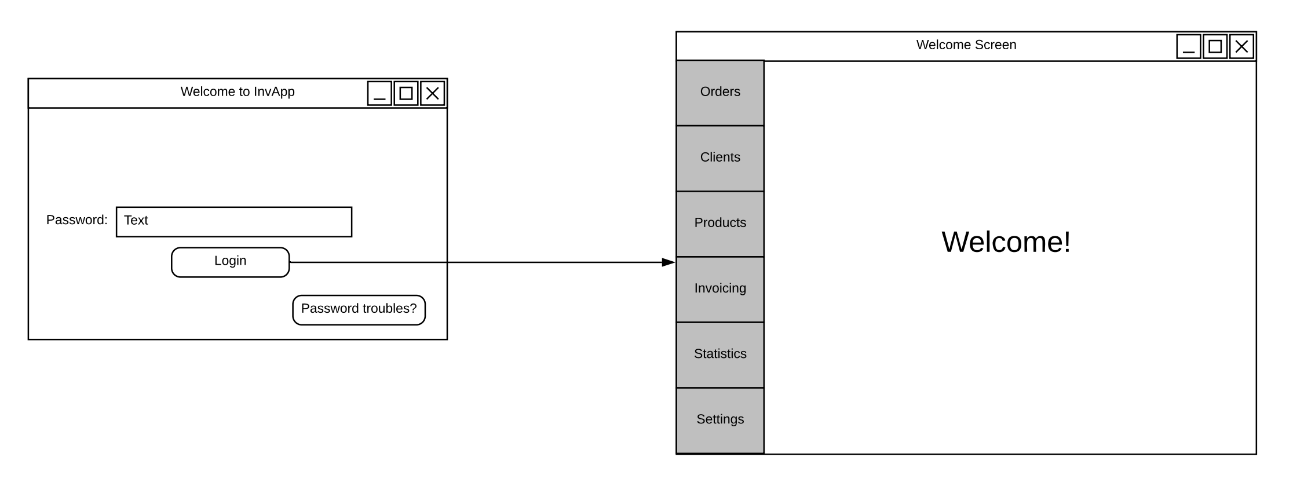
Login

Slide 10
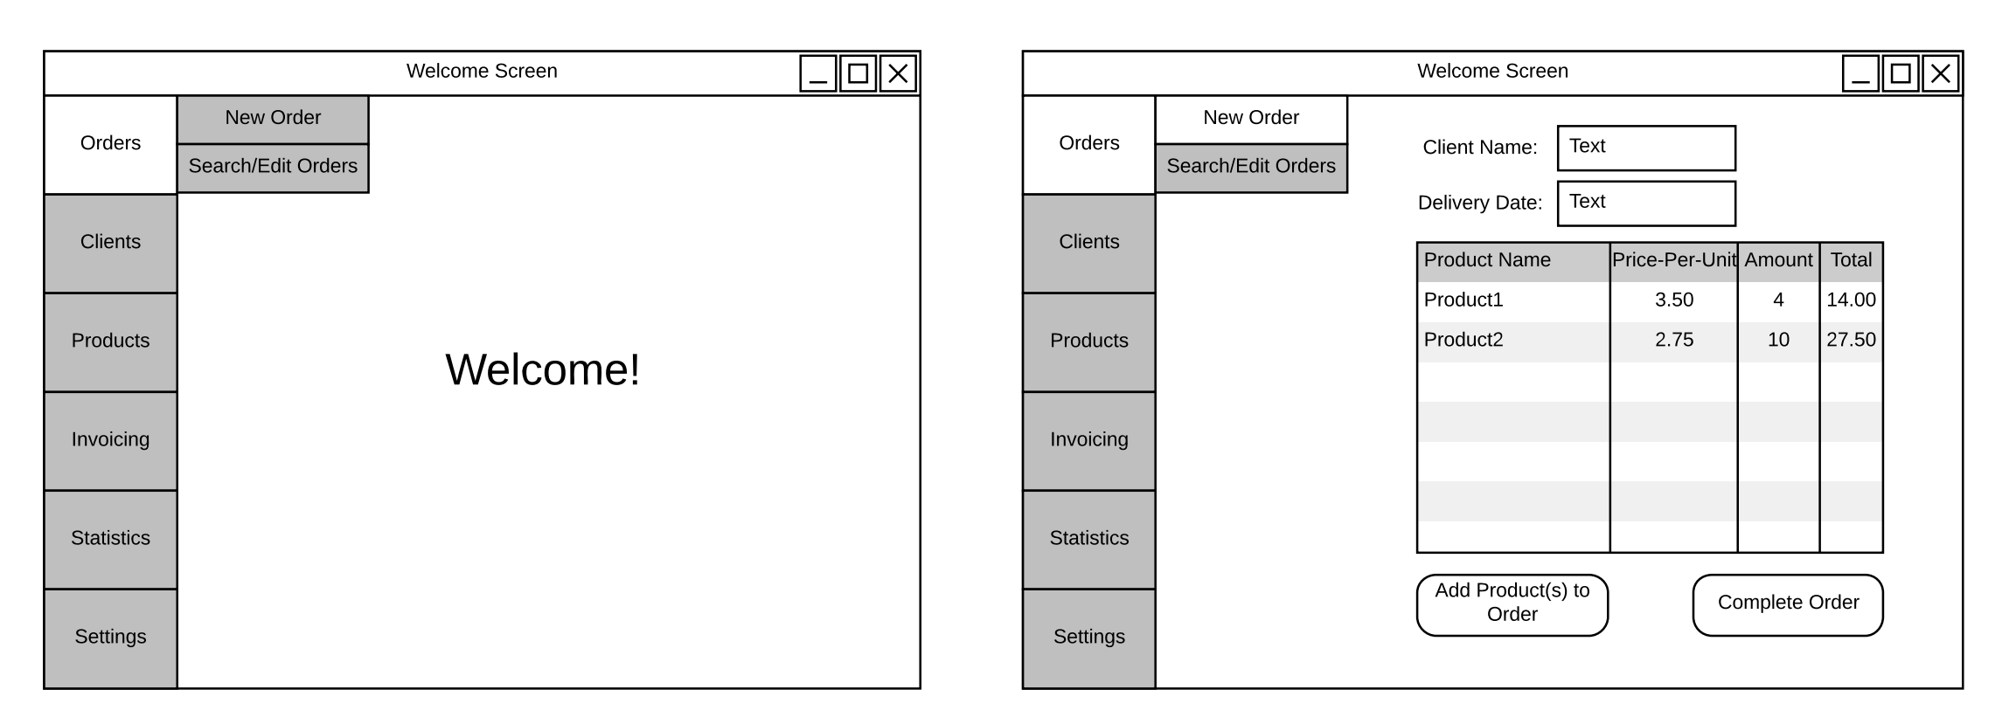
New Orders

Slide 11
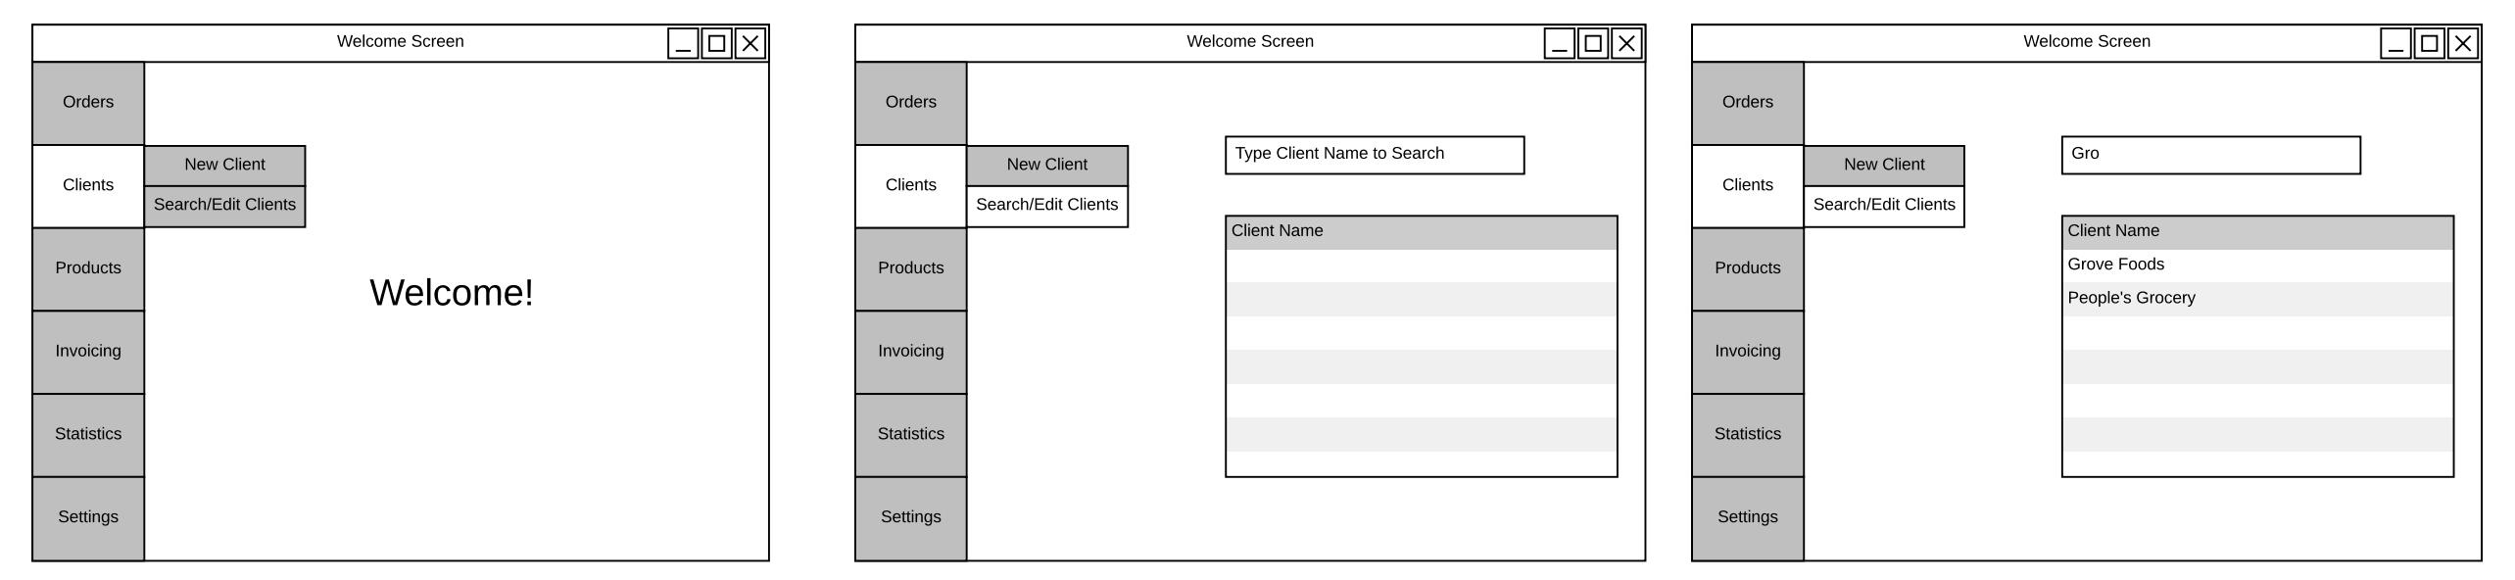
Searching for Client Info

Slide 12
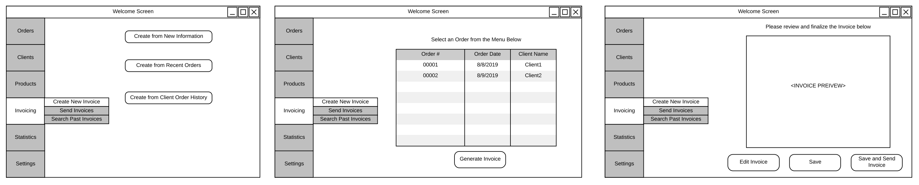
Creating Invoices

Slide 13
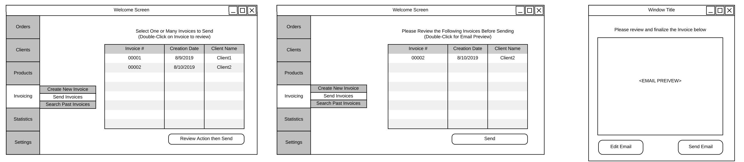
Sending Invoices

Slide 14
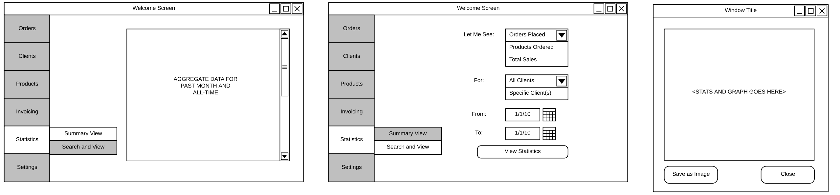
Viewing Statistical Information

Slide 15
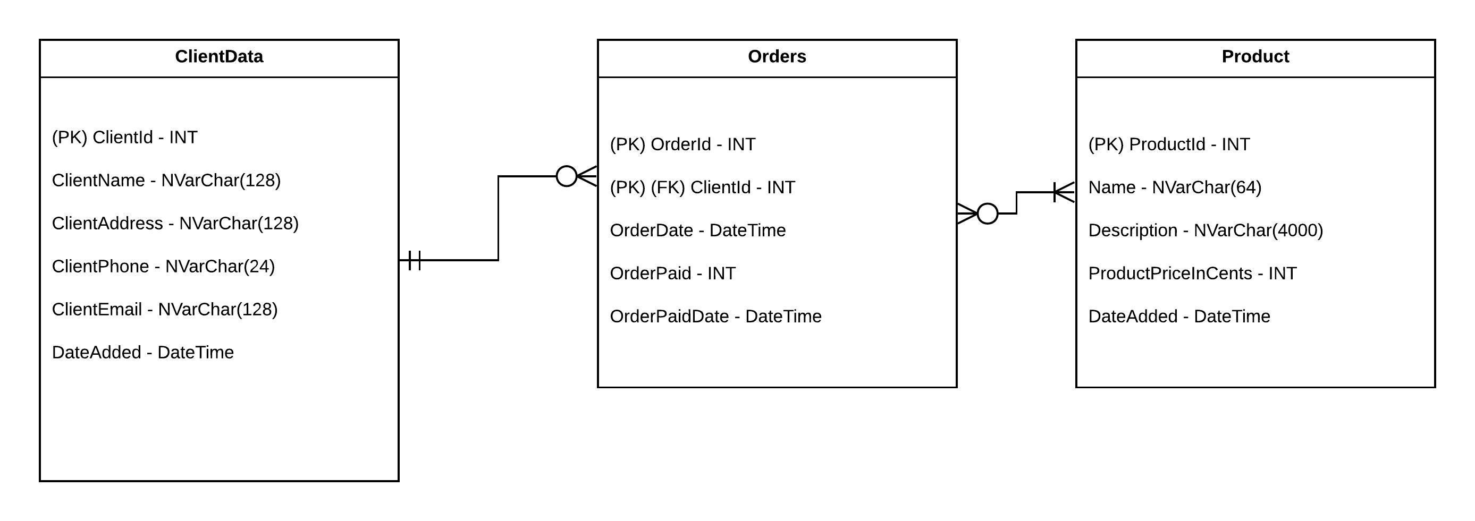
Database Structure

Slide 16
Current Progress
Lots of time dedicated to learning the LGPL version of Qt
Less features and no updated Qt designer => GUI coding w/o designer interface
MVC framework in python/pyqt5 has been created and properly connected
Basic GUI created

Slide 17
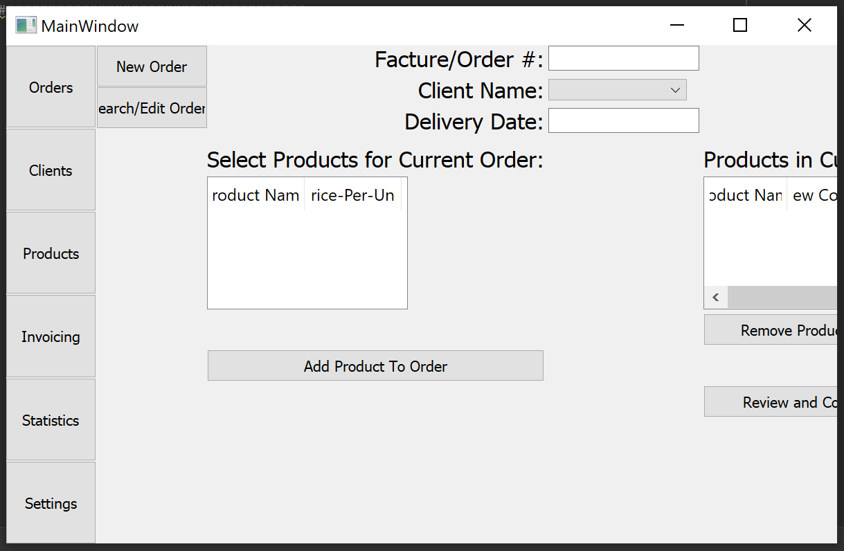

Slide 18
Current Issues
GUI sizing/resizing by user
Need more time to figure out Qt parameters to account for this
Portability
Program will need to include a complete installer so that user can instantly start using the program
Pysqlcipher3 has a few levels of dependencies (i.e. pysqlcipher => SQL cipher => OpenSSL library)
May need to switch to alternative security method of encrypting the database when not in use and decrypting upon user input of the password

Slide 19
Timeline
Late-October
Begin/Finalize GUI Design (Main Page GUI, Invoicing GUI, Statistical Analysis GUI)
Finalize libraries used for deliverables (libs may change due to usability, e.g. email interface may be easier depending on email client used)
Finalize Database Design
Begin/Complete UML Diagram for application
Early-November:
Begin/Complete GUI code for Main Page
Begin/Complete Database functionality and Security code
Begin/Complete Auto-Invoice Email integration
Begin Statistical Analysis Code & GUI implementation
Late-November:
Complete Statistical Analysis Code and begin full application testing
Early-December:
Complete application testing/debugging and enhance GUI and/or add-in stretch goals

Slide 20
Questions?

